Slide 1
HTML TAGS
MCNDHS
Ms. Eng

Slide 2
AIM: FORM -DROPDOWN
Do now:
Open up google classrooms.
codepen.io
Daily Grade:
On-time/attendance/not leaving the classroom: 25%
Cellphones: 25%
Notes:25%
Classwork/Homework: 25%

Slide 3
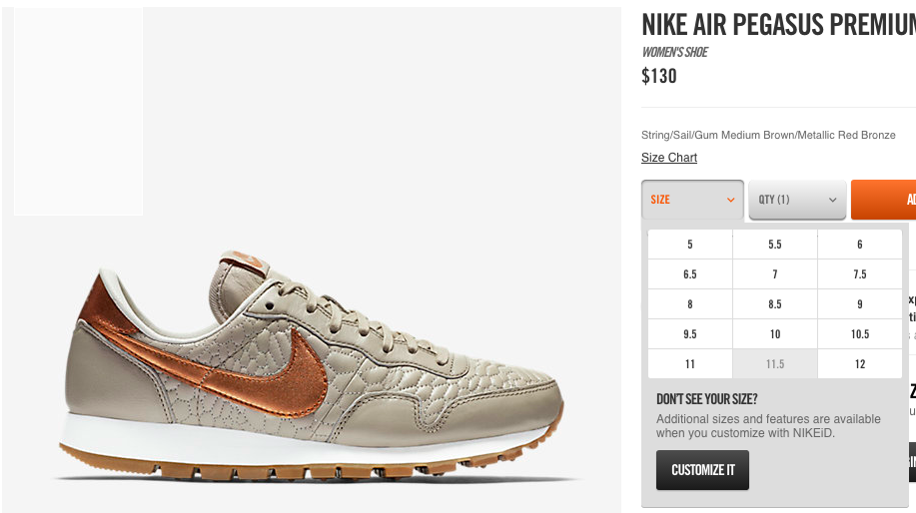
WHERE YOU SEE IT

Slide 4
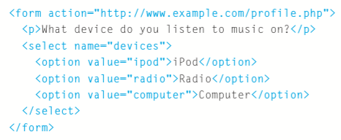
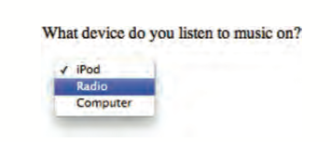
HTML CODE

Slide 5
